Slide 1
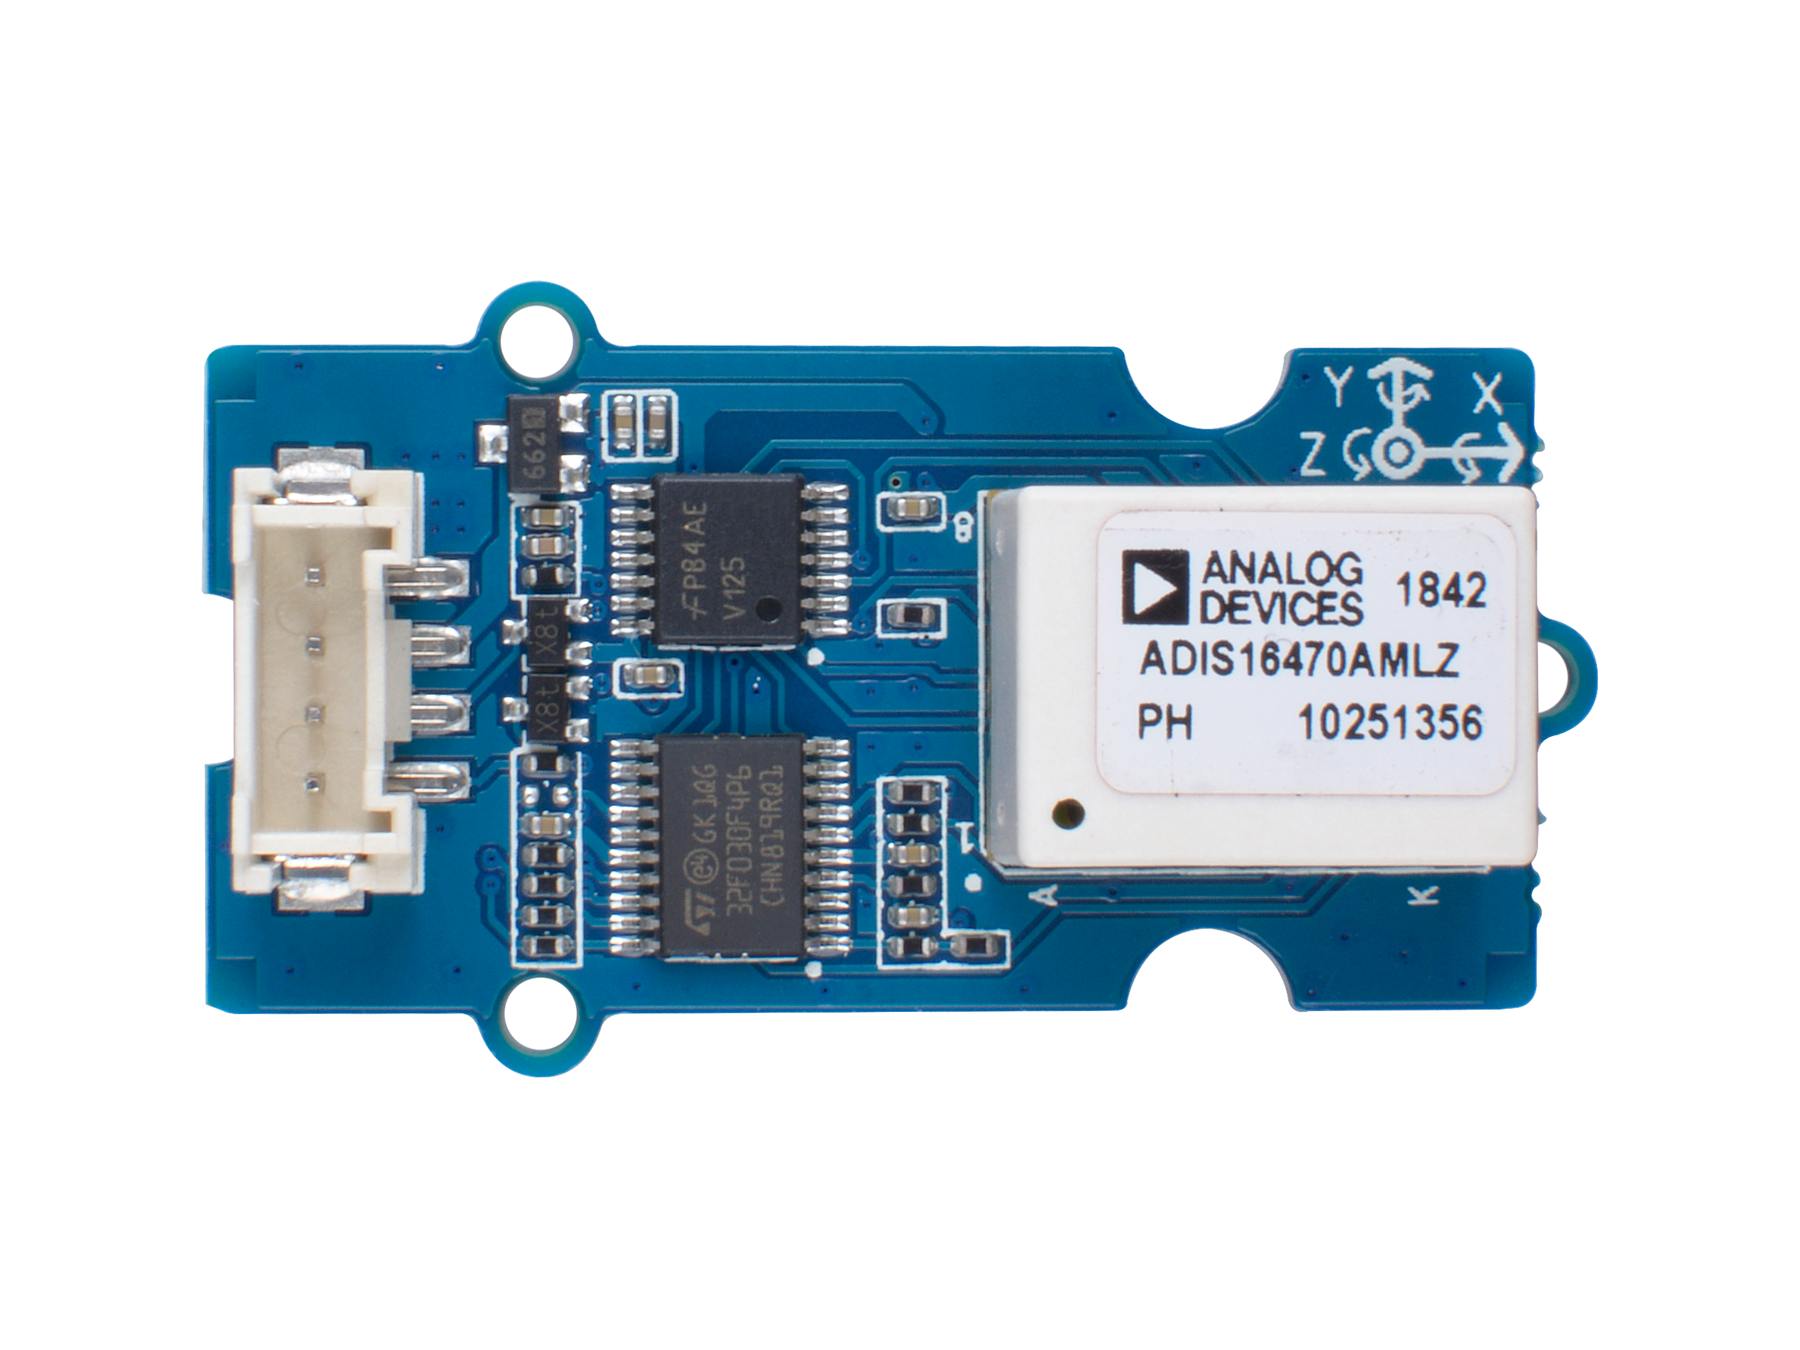




ADIS16470 IMU
GND: connect this module to the system GND
VCC: you can use 5V or 3.3V for this module
SDA: serial data of I2C
SCL: serial clock of I2C

Slide 2
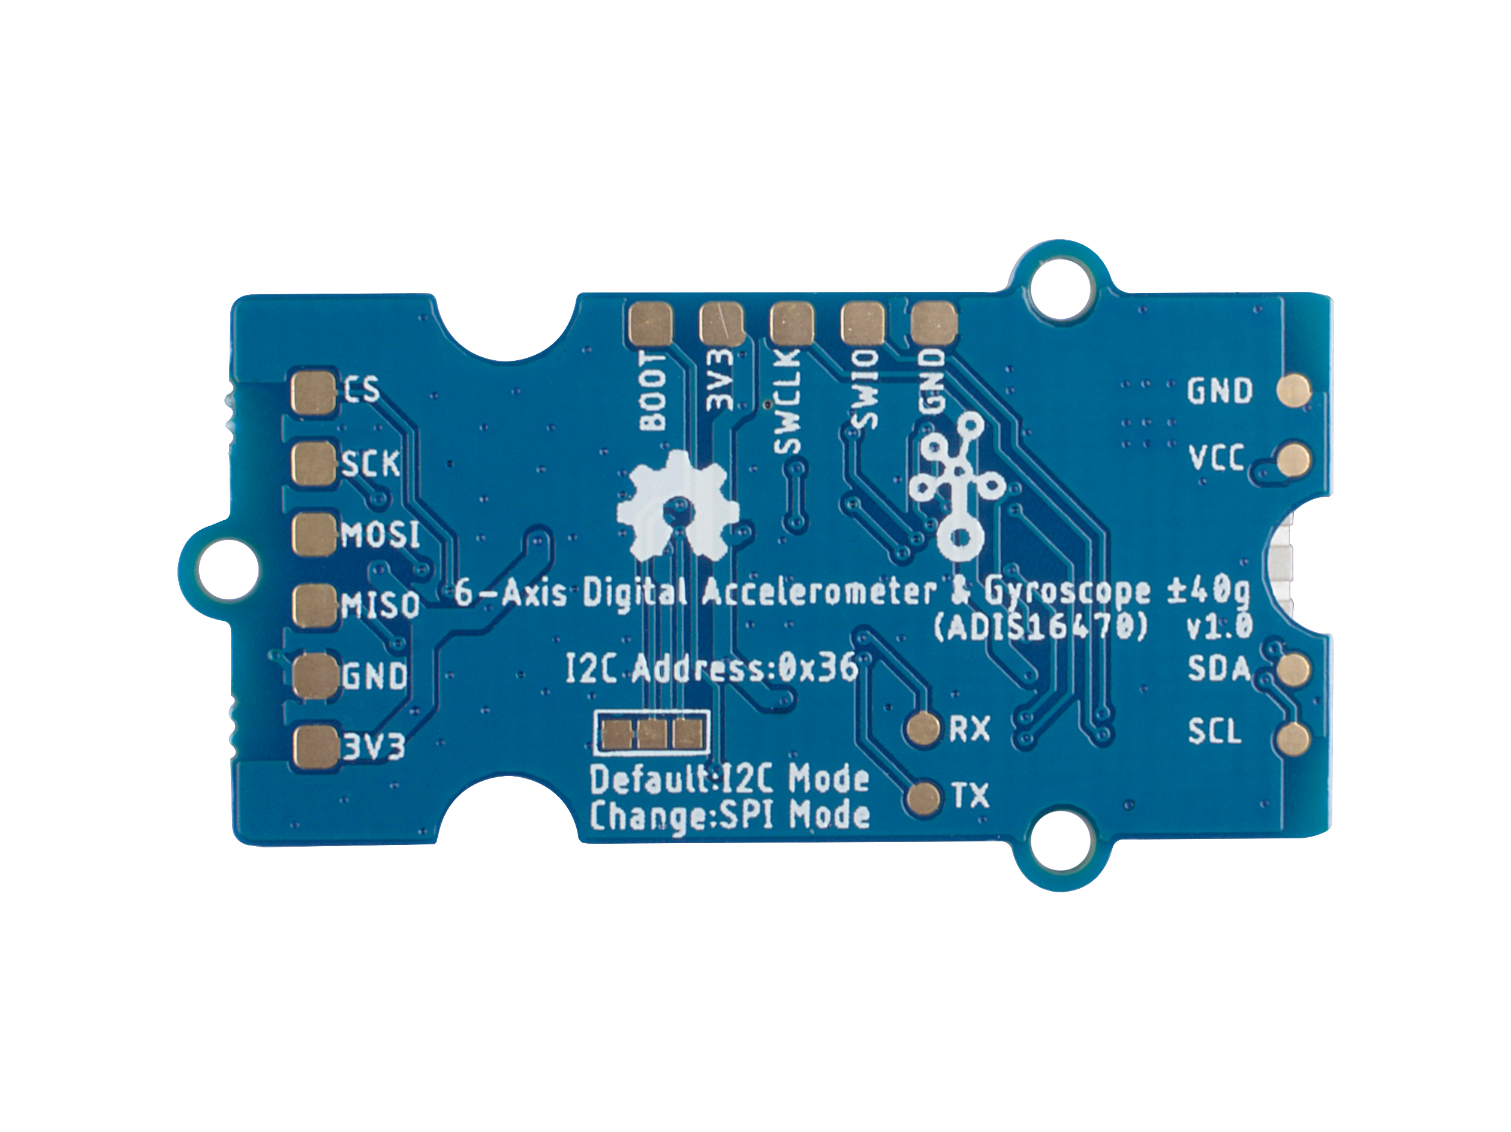
SWD Interface
SPI Interface
I2C Mode-Default
SPI Mode-Selectable

